Slide 1

Term Deposit Prediction Project 9867
This project analyses a dataset from a Portuguese bank to predict whether a customer will subscribe to a term deposit based on their demographics, campaign interactions, and previous campaign outcomes.

Slide 2
Introduction to the Dataset
The dataset encompasses customer data, campaign information, and previous campaign performance. The data is structured, containing both categorical and numerical variables. The objective is to build a predictive model that identifies potential subscribers based on these features.
The target variable is "subscribed," indicating whether a customer subscribed to a term deposit ("yes" or "no"). This binary classification task requires building a model that accurately distinguishes between subscribers and non-subscribers.

Slide 3



Modeling Approach
Model Selection
1
Experimented with models such as Logistic Regression, Random Forest, Gradient Boosting (XGBoost), and Support Vector Machines (SVM).
Model Training and Tuning
2
Training the chosen model using the cleaned and prepared dataset. Hyperparameter tuning is used to optimize the model for the specific task.
Cross-Validation
3
Evaluating the model's performance on unseen data, ensuring its generalization ability and preventing overfitting.

Slide 4
Exploratory Data Analysis
Data Cleaning and Preprocessing
Univariate and Bivariate Analysis
Data Visualization
Identifying and handling missing values, outliers, and inconsistencies in the dataset.
Exploring individual features and their relationships with the target variable. This helps understand the underlying patterns in the data.
Using bar chart, scatter plots, and other visualizations to gain insights into the data distribution and relationships between variables.

Slide 5
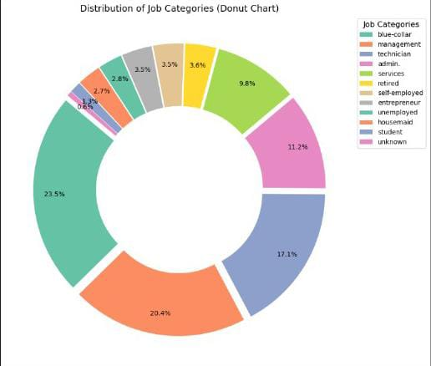
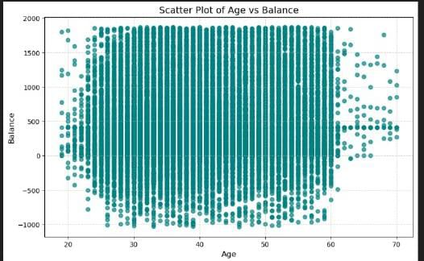
Data Visualization
Donut Chart
Scatter Plot

Slide 6
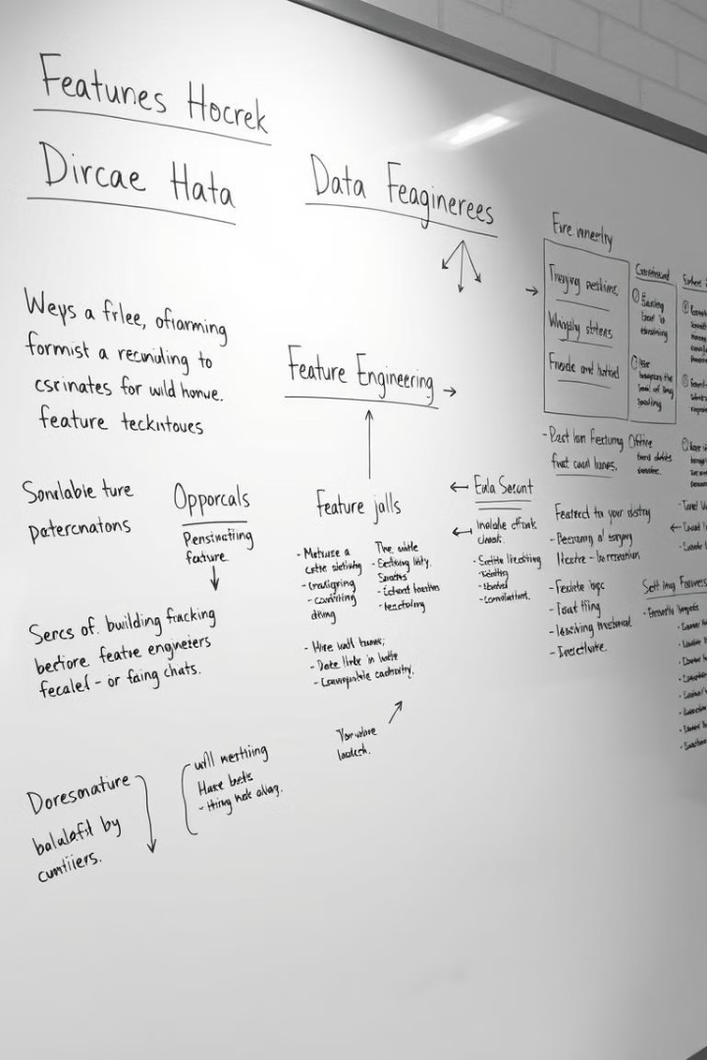



Feature Engineering and Selection
Feature Engineering
Creating new feature from existing ones to improve model performance. This could involve transforming categorical variables, combining variables, or generating interaction terms.
Feature Selection
Identifying and selecting the most relevant features that contribute most significantly to the prediction task. This helps improve model efficiency and reduces overfitting.
Model Optimization
Optimizing the chosen features through techniques like feature scaling and normalization, improving model training and accuracy.

Slide 7
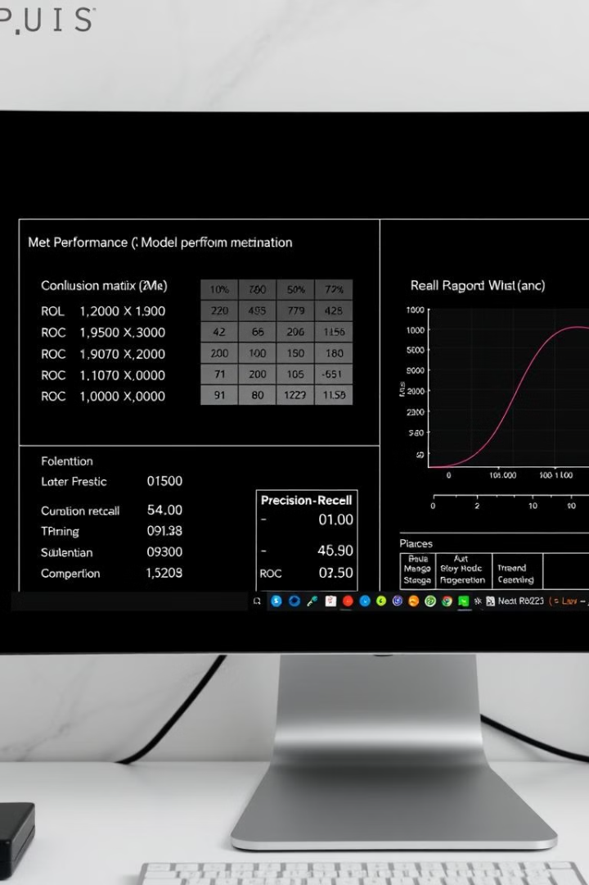
Model Performance and Evaluation
58.46%
60.68%
F1 Score
Accuracy
Balanced measure of precision and recall.
Measuring
the overall correctness of the model's predictions.
61.11%
Precision
Measuring the proportion of correctly predicted positive cases.

Slide 8

Conclusion and Next Steps
This project successfully developed a predictive model to identify potential term deposit subscribers. Further research can investigate more advanced machine learning models, incorporate real-time data feeds, and analyze the impact of changing economic conditions.

